Slide 1

TEST DESIGN TECHNIQUES

Slide 2


DEFINITION
A test design technique is a standardized method to derive, from a specific test basis, test cases that realize a specific coverage. Designing test cases is the vital link between the test strategy and the concrete test cases that are used to implement that test strategy.

Slide 3



There are two main categories of Test Design Techniques, They are:
Categories
Static: Static techniques test software without executing it
Dynamic: Testing that involves the execution of the software of a component or system

Slide 4








STATIC TECHNIQUES
Static Techniques
Informal Reviews
Static Analysis
Walkthroughs
Inspections
Control Flow Structure
Data Flow Structure
Technical Reviews

Slide 5


STATIC TEST DESIGN TECHNIQUES
The Static test design techniques are the testing techniques that involve testing without executing the code or the software application. So, basically static testing deals with Quality Assurance, involving reviewing and auditing of code and other design documents.
The various static test design techniques can be further divided into two parts – “Static testing performed manually” and “Static testing using tools”.

Slide 6


MANUAL STATIC DESIGN TECHNIQUES
a) Informal reviews: As the name suggests, an informal review done by an individual without any process or documentation.
b) Walkthrough A Walk-through is a step-by-step presentation of different requirements and design documents by their authors. This is done with the intent of finding defects or any missing pieces in the documents.
c) Inspection An inspection is a formal and documented process of reviewing the different documents by experts or trained professionals.
d) Technical reviews A technical review involves reviewing the technical approach used during the development process. It is more of a peer review activity and less formal as compared to audit and inspection.

Slide 7


STATIC DESIGN TECHNIQUES USING TOOLS
Static analysis of code –
The static analysis techniques for the source code evaluation using tools are
a) Control flow analysis –
The control flow analysis requires analysis of all possible control flows or paths in the code.
b) Data flow analysis –
The data flow analysis requires the analysis of data in the application and its different states.

Slide 8


Dynamic Test Design
Techniques
Dynamic test design techniques involve testing by running the system under test. In this technique, the tester provides input data to the application and executes it. This is done to verify its different functional and non-functional requirements.

Slide 9















Specification-Based Techniques
Testing, Either functional or non-functional, without reference to the internal structure of the component or system. These are also called black-box techniques
These are also Called White-Box or structural Techniques
Dynamic Techniques
Structure-Based
Specification-Based
Equivalence Partitioning
Experience-Based
Statement
Boundary Values Analysis
Decision
Decision Tables
Error Guessing
Condition
State Transition
Exploratory testing
Use Case Testing
Multiple Condition

Slide 10


Specification-Based Techniques
Specification-based test design techniques are also referred to as black-box testing. These involve testing based on the specification of the system under test without knowing its internal architecture. The different types of specification-based test design or black box testing techniques are – “Equivalence partitioning”, “Boundary value analysis”, “Decision tables”, “Cause-effect graph”, “State transition testing” and “Use case testing”.

Slide 11

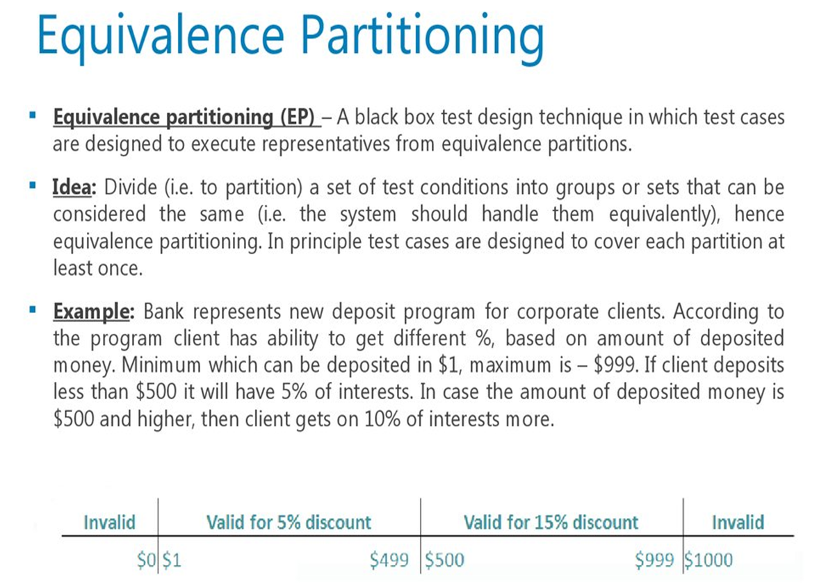

Slide 12

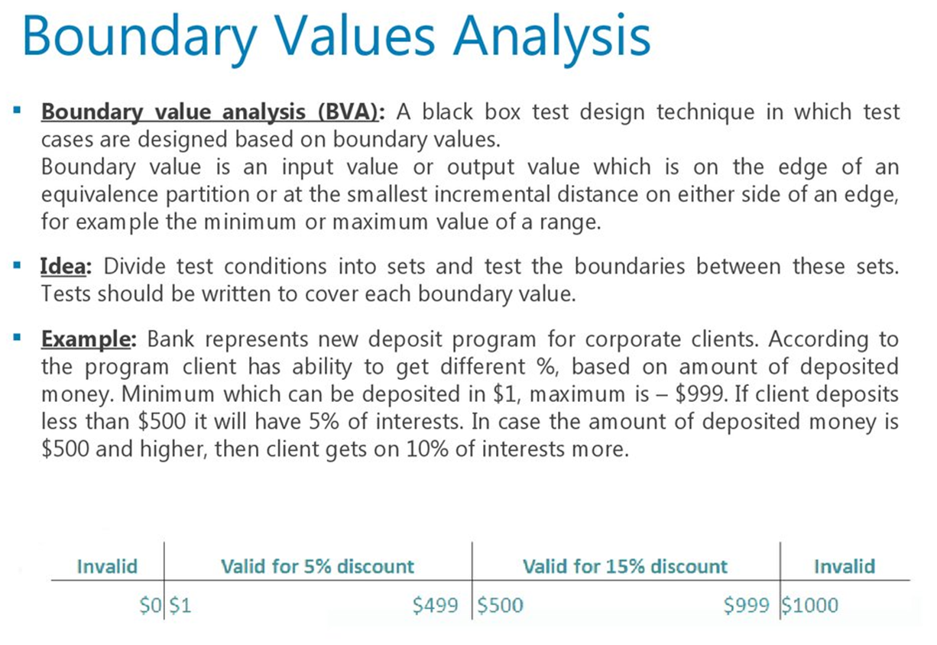

Slide 13

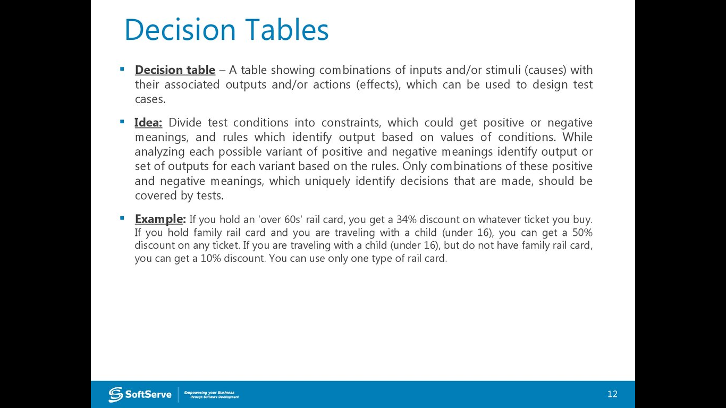

Slide 14

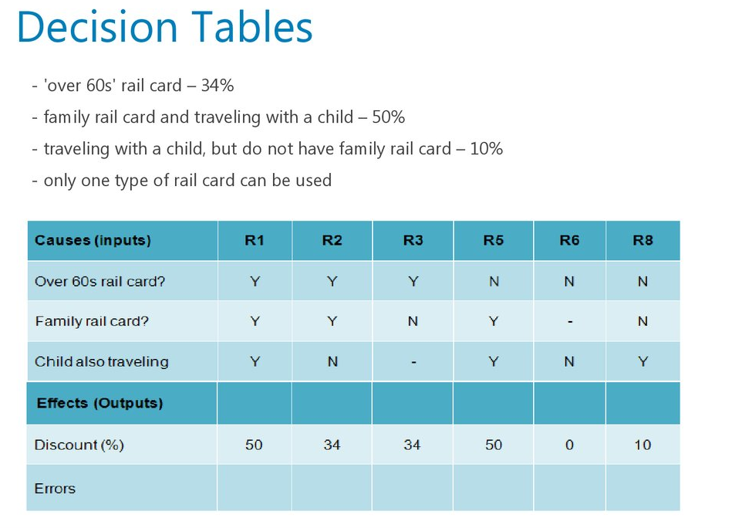

Slide 15

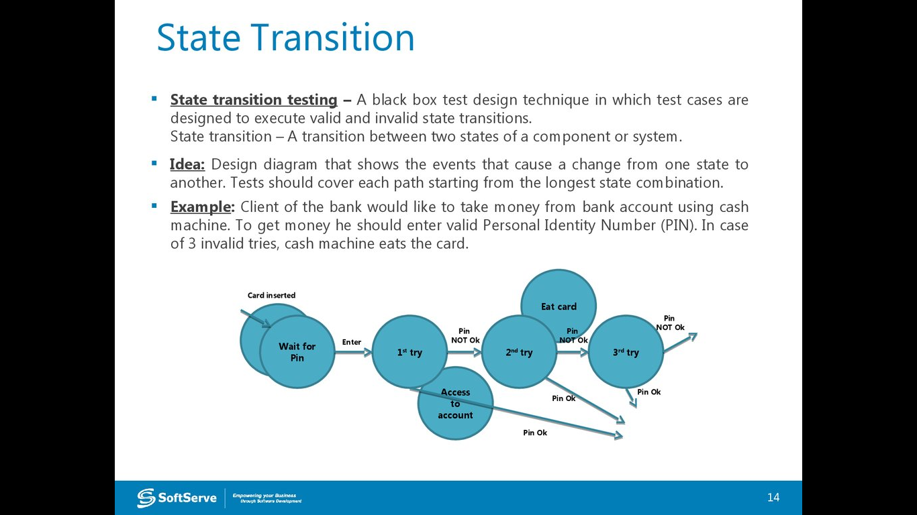

Slide 16
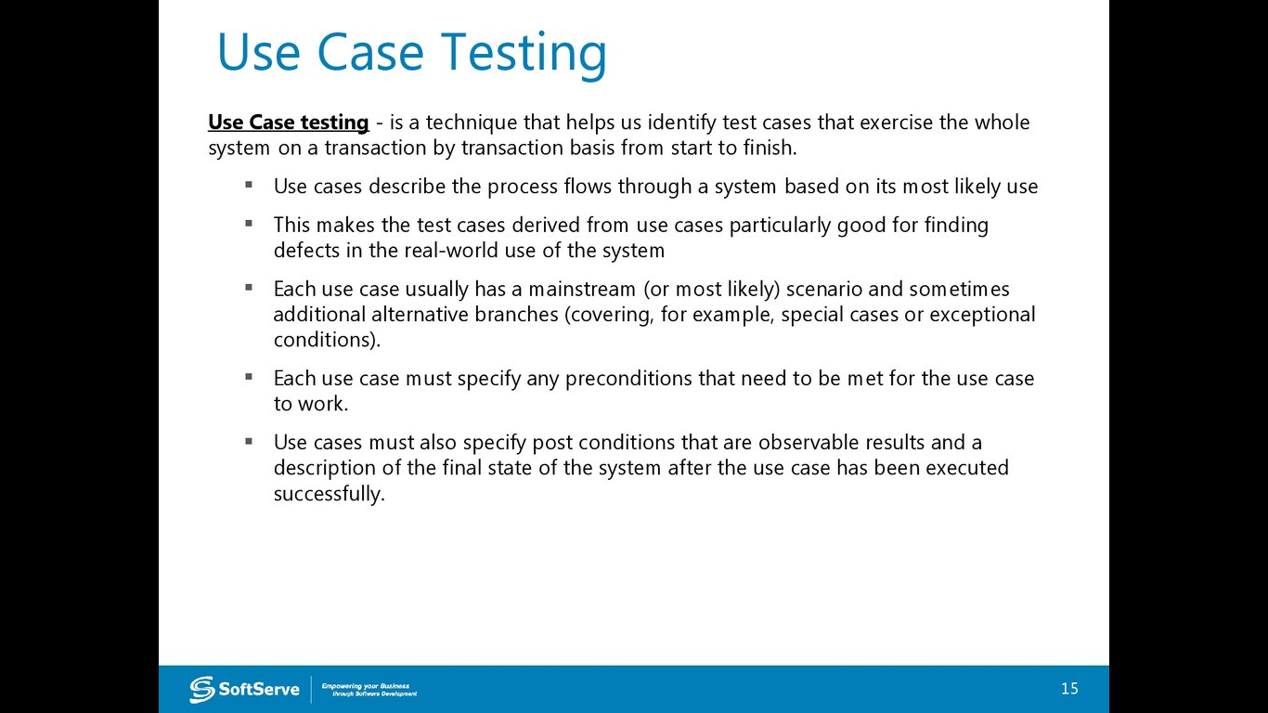

USE CASE TESTING

Slide 17


STRUCTURE-BASED
TECHNIQUES
Procedure to derive and/or select test cases based on an analysis of the internal structure of a component or system. These are also called white-box technique
Dynamic Techniques
Structure-Based
Specification-Based
Equivalence Partitioning
Statement
Experience-Based
Boundary Values Analysis
Decision
Decision Tables
Error Guessing
Condition
State Transition
Exploratory testing
Multiple Condition
Use Case Testing

Slide 18

STRUCTURE-BASED TECHNIQUES
Structure-based test design techniques are also referred to as white box testing. In these techniques, the knowledge of code or internal architecture of the system is required to carry out the testing. The various kinds of testing structure-based or white testing techniques are – “Statement testing”, “Decision testing/branch testing”, “Condition testing”, “Multiple condition testing”.

Slide 19
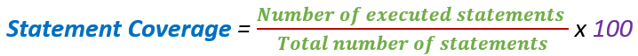
Statement Coverage
Statement Coverage is a white box testing technique in which all the executable statements in the source code are executed at least once. It is used for calculation of the number of statements in source code which have been executed. The main purpose of Statement Coverage is to cover all the possible paths, lines and statements in source code.
Statement coverage is used to derive scenario based upon the structure of the code under test.

Slide 20

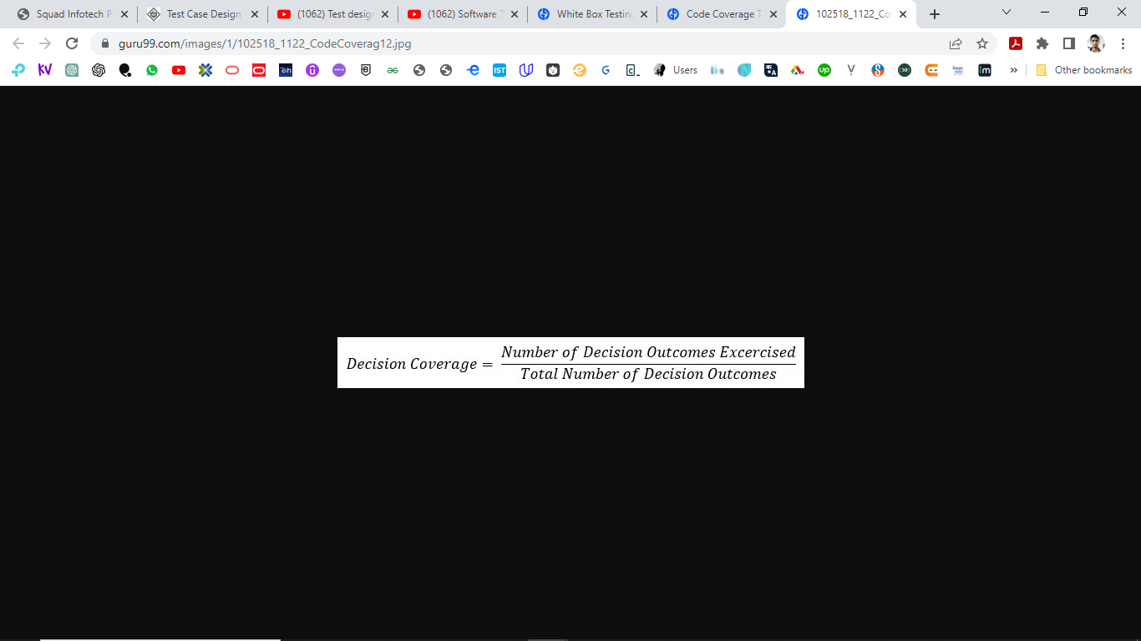
Decision Coverage Testing
Decision Coverage is a white box testing technique which reports the true or false outcomes of each boolean expression of the source code. The goal of decision coverage testing is to cover and validate all the accessible source code by checking and ensuring that each branch of every possible decision point is executed at least once.
In this coverage, expressions can sometimes get complicated. Therefore, it is very hard to achieve 100% coverage. That’s why there are many different methods of reporting this metric. All these methods focus on covering the most important combinations. It is very much similar to decision coverage, but it offers better sensitivity to control flow.

Slide 21


Condition Coverage Testing
Condition Coverage or expression coverage is a testing method used to test and evaluate the variables or sub-expressions in the conditional statement. The goal of condition coverage is to check individual outcomes for each logical condition. Condition coverage offers better sensitivity to the control flow than decision coverage. In this coverage, expressions with logical operands are only considered.
For example, if an expression has Boolean operations like AND, OR, XOR, which indicates total possibilities.
Condition coverage does not give a guarantee about full decision coverage.
The formula to calculate Condition Coverage:

Slide 22

Multiple Condition Coverage
All the possible combinations of outcomes of conditions in a decision (therefore the complete decision table) are tested at least once. Since there are only two possible outcomes of a condition (TRUE or FALSE), 2 is the basis for the number of test situations that can be created. The maximum number of test situations (the complete decision table) depends on the amount of conditions: 2^{n} , where N is the amount conditions.

Slide 23


EXPERIENCE-BASED
TECHNIQUES
Dynamic Techniques
Structure-Based
Specification-Based
Equivalence Partitioning
Statement
Experience-Based
Boundary Values Analysis
Decision
Decision Tables
Error Guessing
Condition
State Transition
Exploratory testing
Multiple Condition
Use Case Testing

Slide 24


EXPERIENCE-BASED
TECHNIQUES
The experienced-based techniques as the name suggest do not require any systematic and exhaustive testing. These are completely based on the experience or intuition of the tester. The two most common forms of experienced-based testing are –Error Guessing and Exploratory testing.

Slide 25
Error Guessing
Error Guessing is a simple technique that takes advantage of a tester’s skill, intuition and experience with similar applications to identify special tests that formal Black Box techniques could not identify. For example, pressing the Esc key might have crashed a similar application in the past or pressing the Back button or Enter key on a webpage, Javascript errors etc.
This technique completely depends on the tester’s experience. The more experienced the tester is, the more errors he can identify. Several testers and/or users can also team up to document a list of possible errors, and this can add a lot of value.
Another way of error guessing is the creation of defect and failure lists. These lists can use available defect and failure data as a starting point and can then expand by using the testers’ and users’ experience. This list can be used to design tests and this systematic approach is known as fault attack.

Slide 26

Exploratory Testing
This is used when specifications are either missing or inadequate and where there is severe time pressure. A test charter of test objectives is first created and based on the test objectives, test cases are designed, executed and logged, all these activities occur concurrently along with learning about the application within a fixed time frame (time-box). The test objectives help maintain the focus and maximize testing within the limited time frame.

